Slide 1
APUSH Review: The Election of 1896
Everything You Need To Know About The Election of 1896To Succeed In APUSH

Slide 2
Background Info
Grover Cleveland (22nd and 24th President) is NOT re-nominated by the Democrats
Panic of 1893 hurt many Americans, especially farmers
20% of Americans unemployed at its worst
Currency issue dominated politics
Gold v. silver

Slide 3
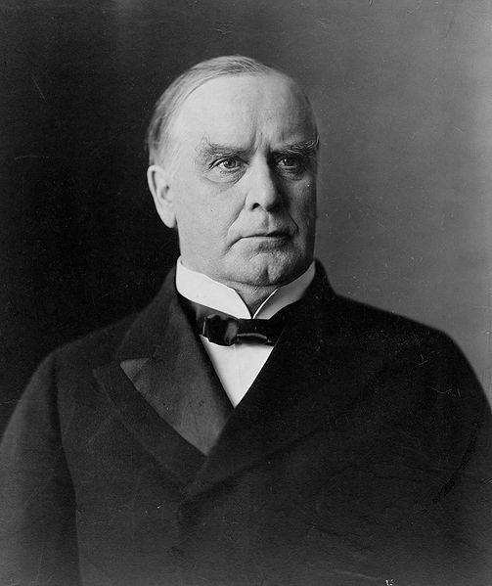
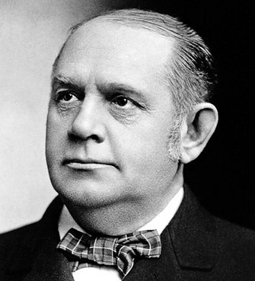
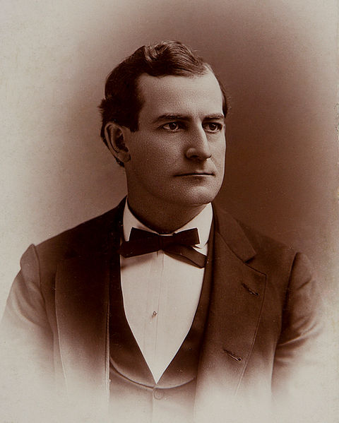
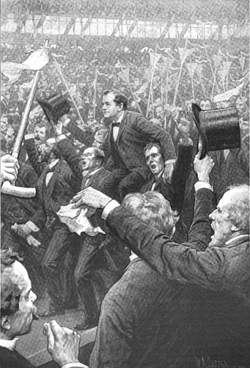
The Candidates
Democratic Candidate:
“Dark Horse” candidate William Jennings Bryan
Great orator, gave a famous speech, “Cross of Gold” at Convention
Republican candidate:
William McKinley
Mark Hanna (essentially McKinley’s campaign manager) built huge war chest of funds
5 times as much money as Bryan
“You shall not press down upon the brow of labor this crown of thorns; you shall not crucify mankind upon a cross of gold”

Slide 4
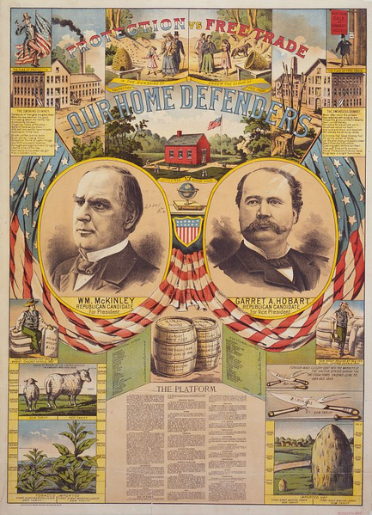
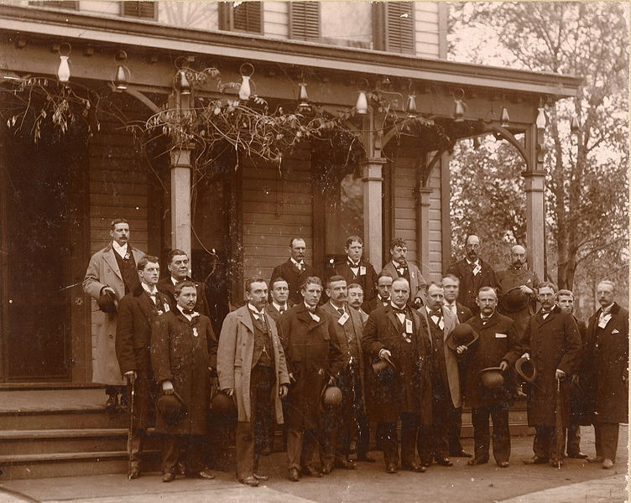
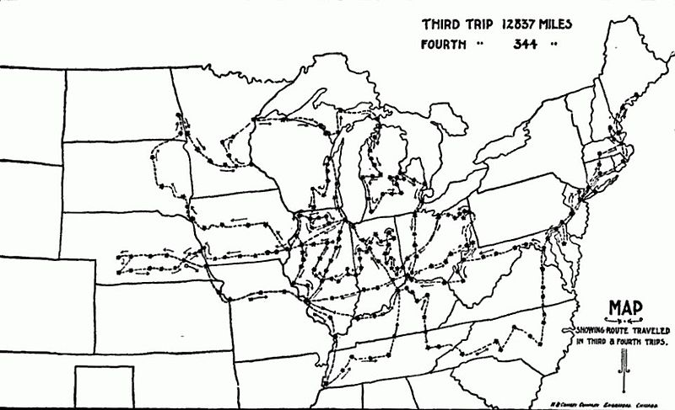
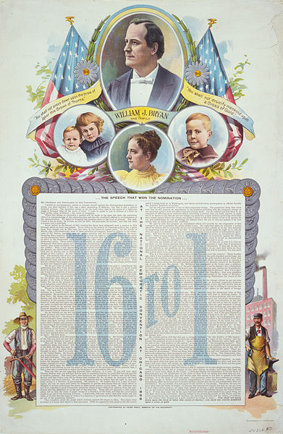
The Issues and Campaign
“Free Silver”:
Favored by Bryan and Democrats
Advocated the free and unlimited coinage of silver at a 16:1 ratio
16 ounces of silver would equal 1 ounce of gold
Why did Bryan advocate “Free Silver?”
Increase the money supply
Help the less wealthy (farmers and debtors)
Tariffs:
Republicans favored high protective tariffs
Remember, Republicans want to Raise tariffs
McKinley’s “Front Porch” v. Bryan’s Railroad campaign

Slide 5
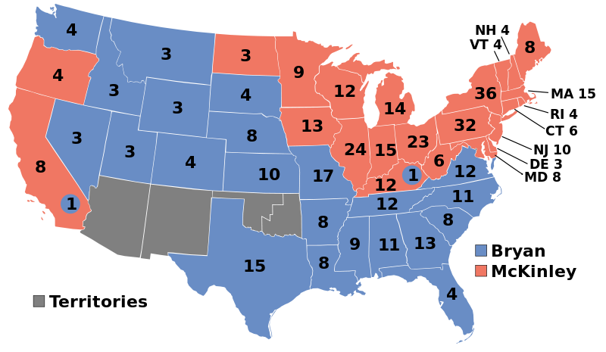
The Results and Impact
McKinley defeats Bryan, 271 – 176
McKinley v. Bryan again in 1900
Beginning of Republican dominance in the Oval Office
McKinley, Roosevelt, Taft

Slide 6
Thanks for watching!
Subscribe to my channel
Help spread the word
Questions? Comments? Ideas for videos?
Leave in comments
Let’s raise tariffs and raise the number of subscribers!
Subscribe
Down here!

